Slide 1
Section 5.4
Polynomial and Rational Inequalities
Copyright © 2012 Pearson Education, Inc. Publishing as Prentice Hall.

Slide 2

Copyright © 2012 Pearson Education, Inc. Publishing as Prentice Hall.

Slide 3

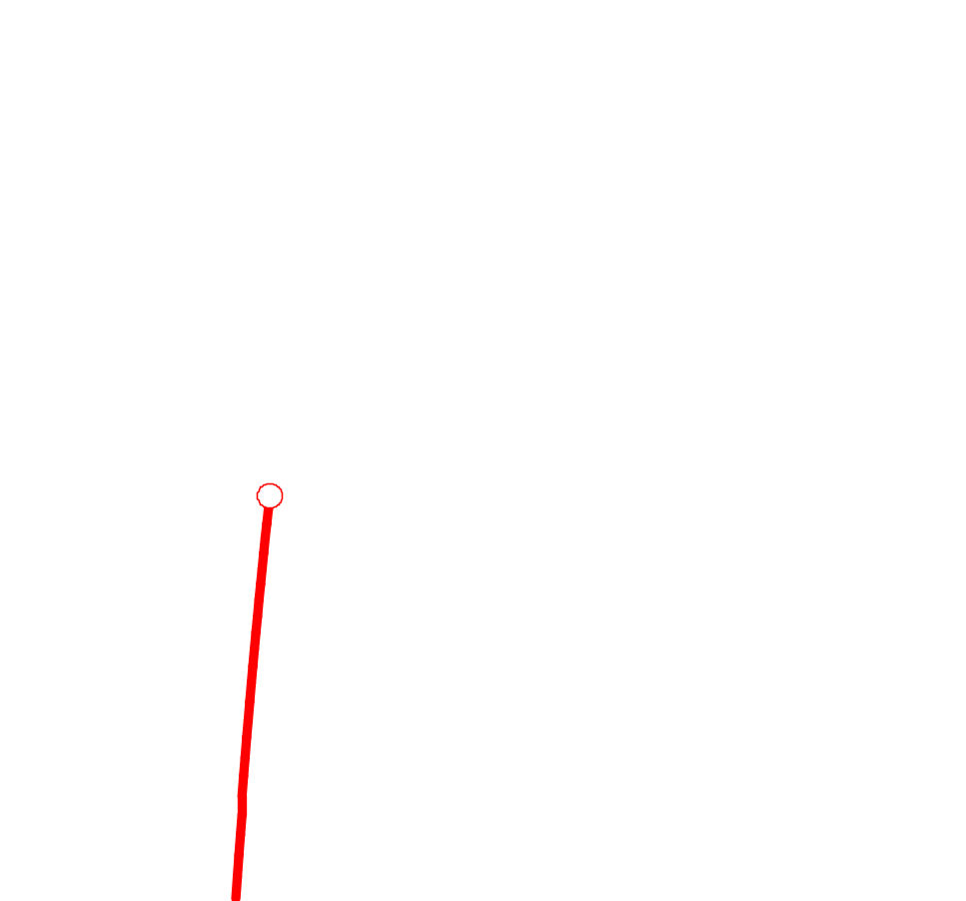
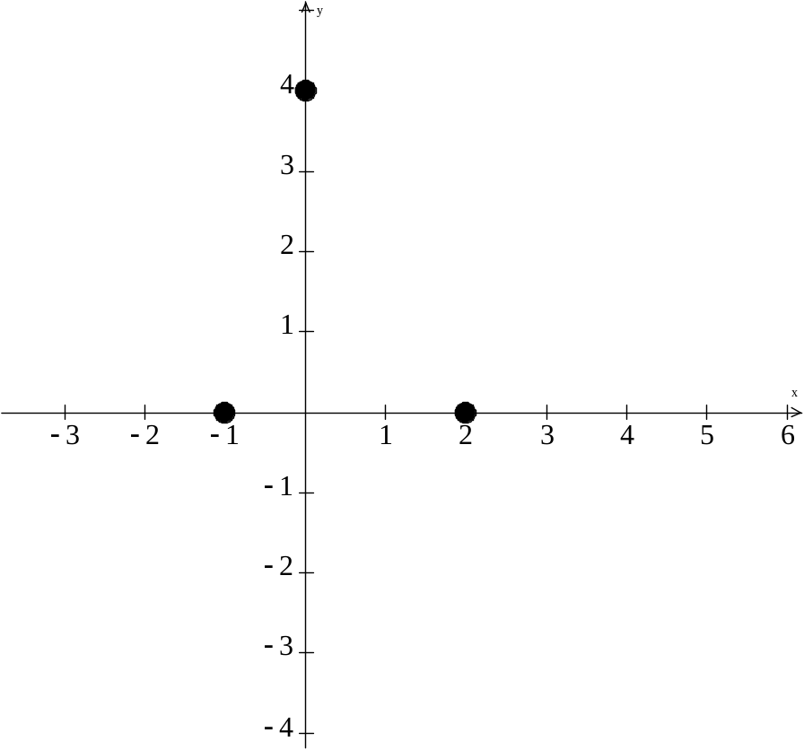
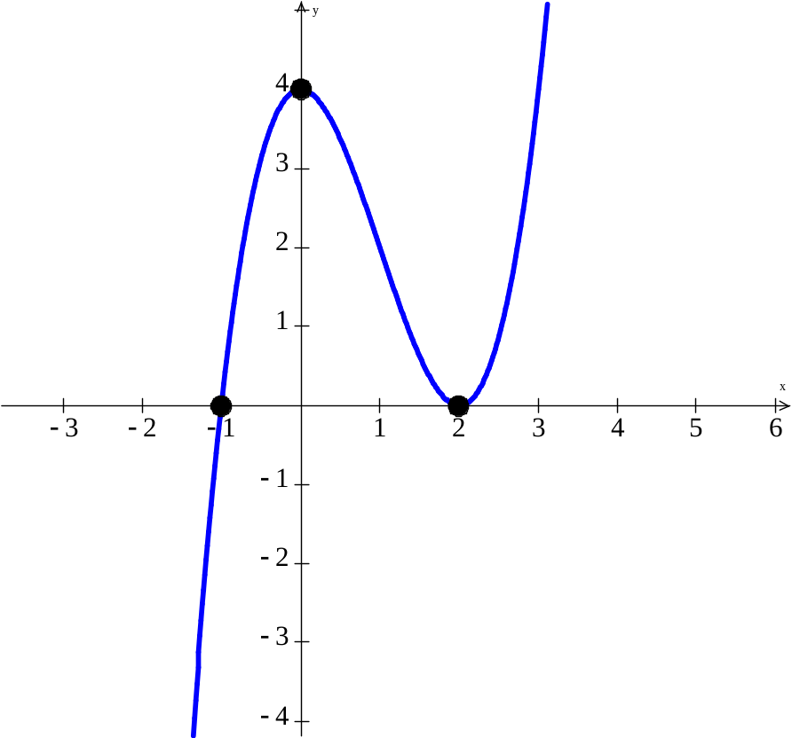
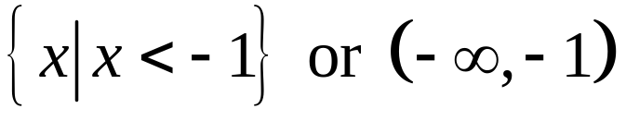
x-intercepts are 2 with multiplicity 2 (touches) and -1 with multiplicity 1 (crosses).
y-intercept is 4.
End behavior is like f(x) = x³.
Where is this function less than 0?
Copyright © 2012 Pearson Education, Inc. Publishing as Prentice Hall.

Slide 4
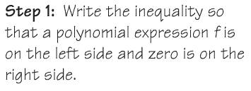






Copyright © 2012 Pearson Education, Inc. Publishing as Prentice Hall.

Slide 5
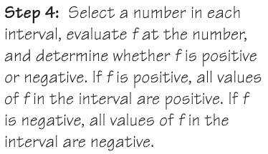

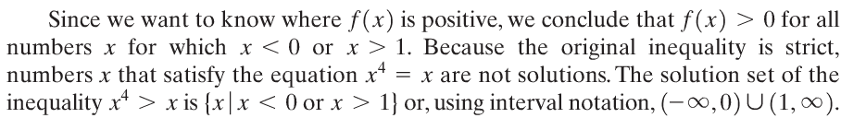
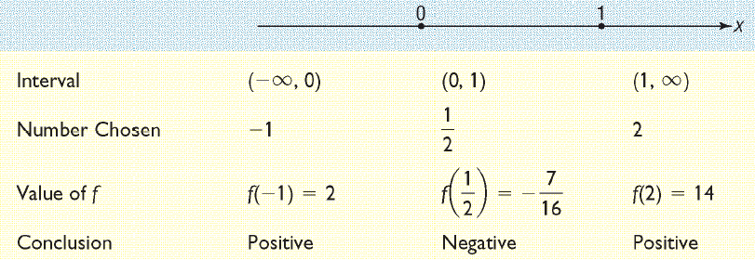
Copyright © 2012 Pearson Education, Inc. Publishing as Prentice Hall.

Slide 6

Copyright © 2012 Pearson Education, Inc. Publishing as Prentice Hall.

Slide 7
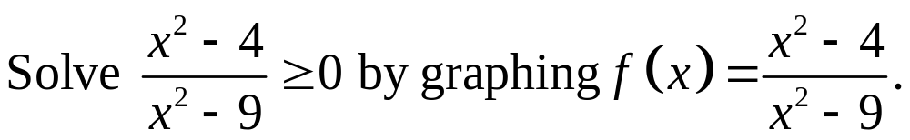
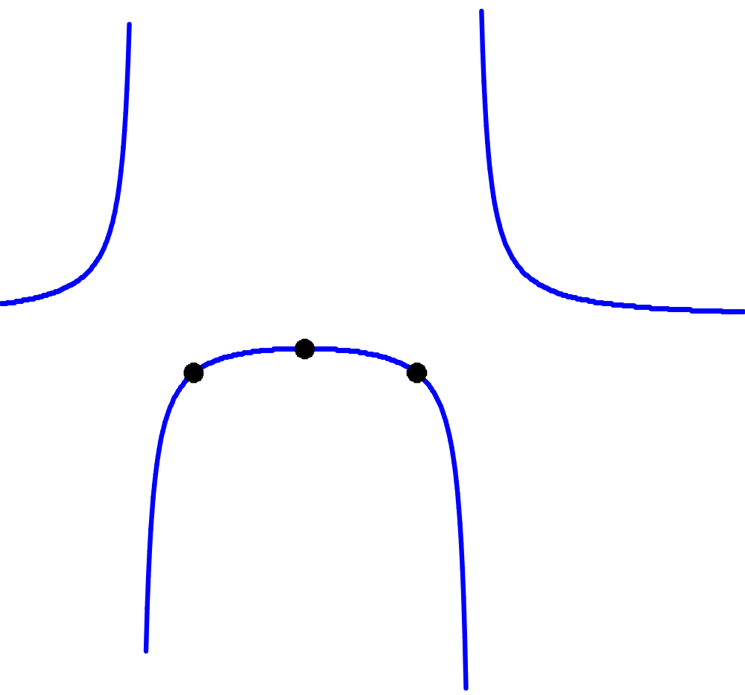
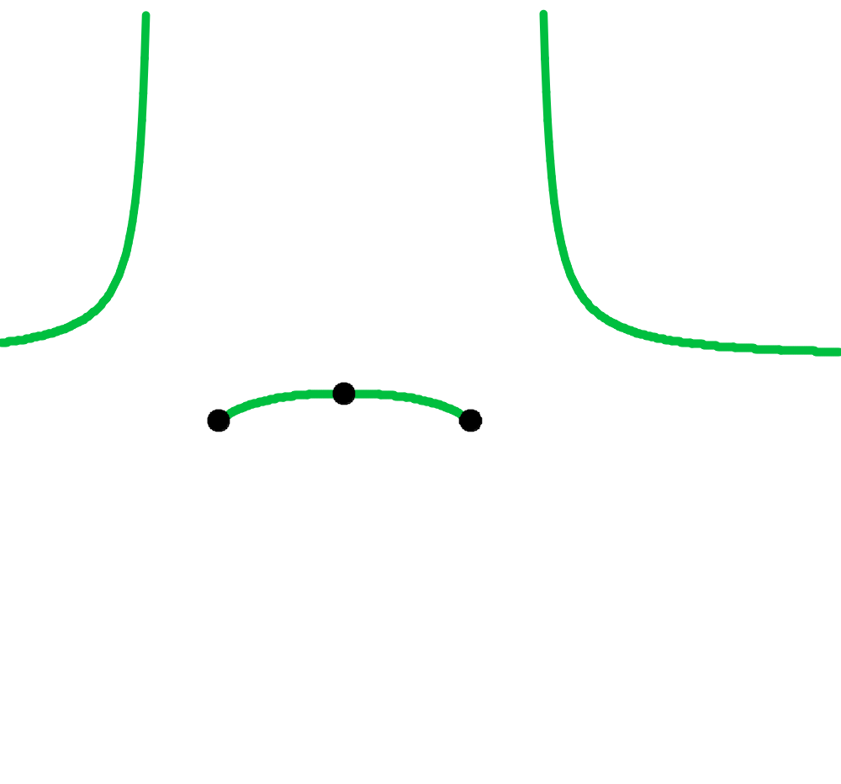
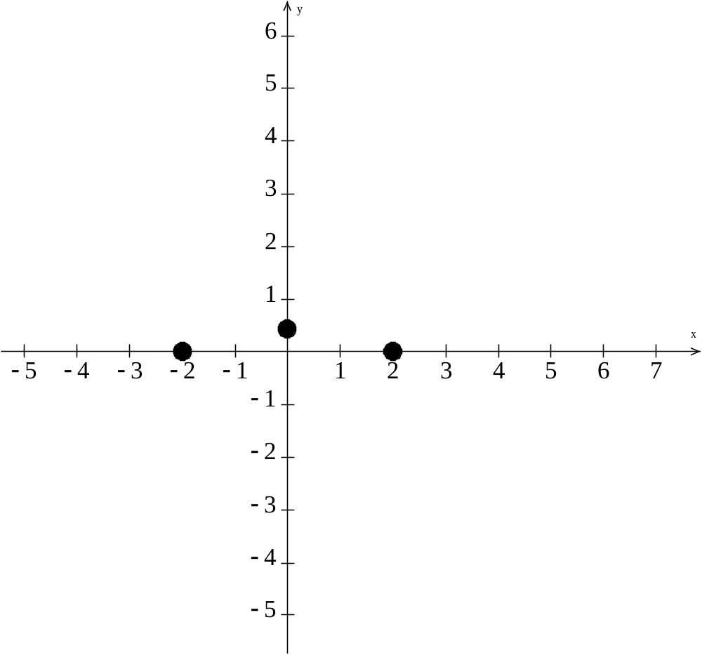
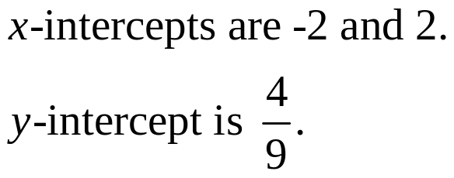

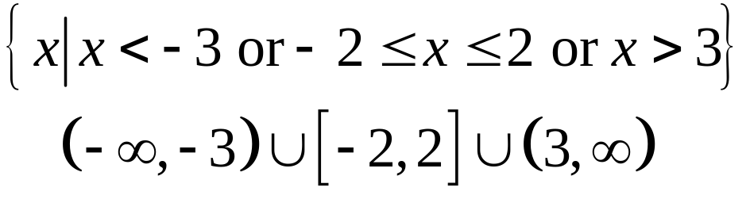
Where is this function greater than or equal to 0?
Copyright © 2012 Pearson Education, Inc. Publishing as Prentice Hall.

Slide 8
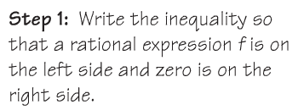




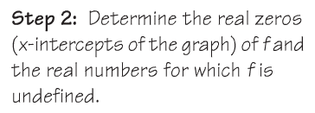


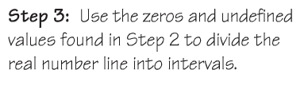
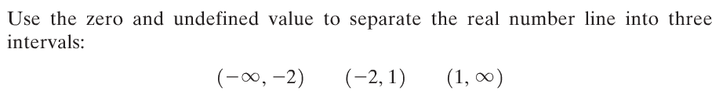
Copyright © 2012 Pearson Education, Inc. Publishing as Prentice Hall.

Slide 9
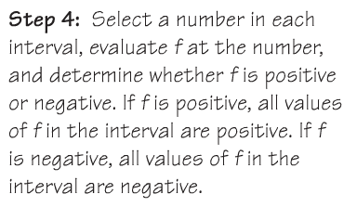

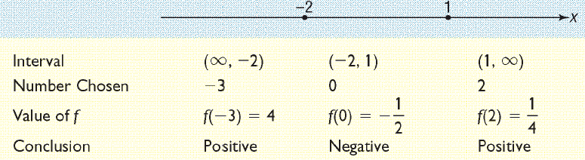
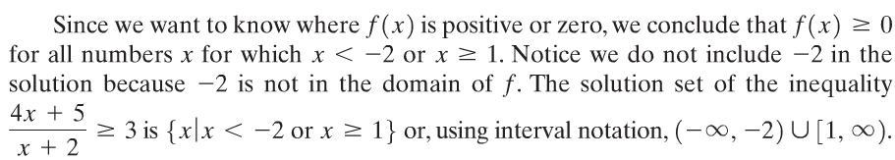
Copyright © 2012 Pearson Education, Inc. Publishing as Prentice Hall.

Slide 10
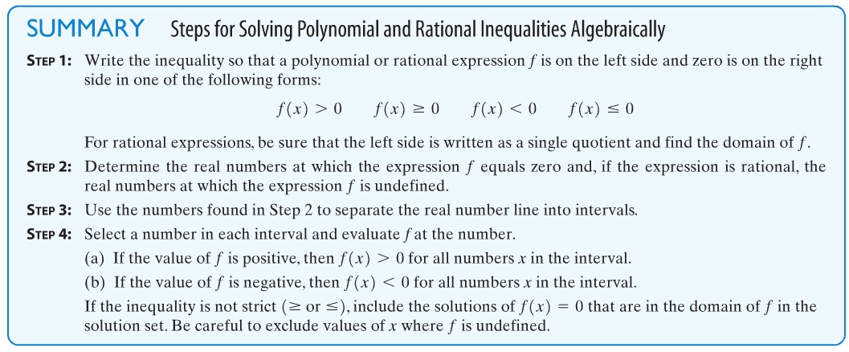
Copyright © 2012 Pearson Education, Inc. Publishing as Prentice Hall.

